Slide 1
Inside the columnstore index
A deep dive into the internals of the
SQL Server 2012 columnstore index
by Hugo Kornelis

Slide 2
Nos sponsors

Slide 3
Hugo Kornelis
Speaker, blogger, author, technical editor, etc.
SQL Server MVP since January 1st, 2006
Blog: http://sqlblog.com/blogs/hugo_kornelis
Contact:
Email: hugo@perFact.info
Twitter: @Hugo_Kornelis

Slide 4
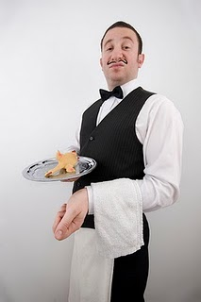
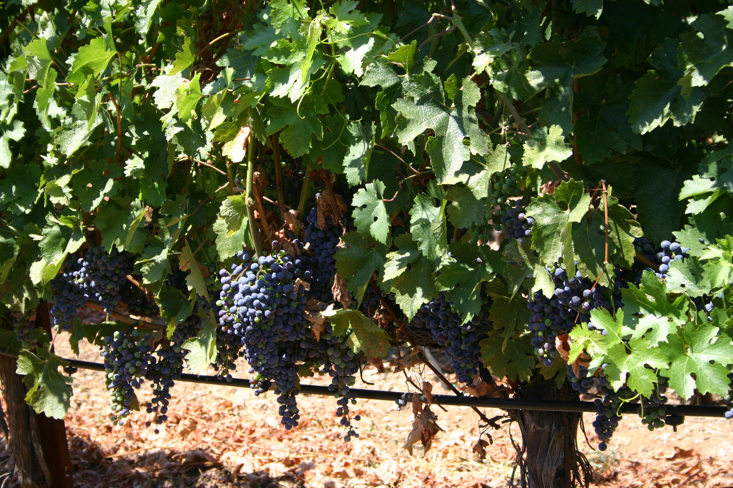
La France

Slide 5
Columnstore index
SQL Server 2012
Nonclustered columnstore index
Read-only
Many limitations
SQL Server 2014
Clustered columnstore index
Read/write
Most limitations lifted

Slide 6
Columnstore index
DEMO

Slide 7
Columnstore index
Where does the speed gain come from?
Less I/O
Column orientation
Segment elimination
Compression
More efficient processing
Batch mode processing

Slide 8
Row oriented vs. column oriented
Traditional, row oriented storage
Saledate ProductName Amt GrossPrice SalesTax NetPrice ...
2012-03-08 Candy bar 50 75.00 14.25 89.25 ...
2012-03-10 Smart phone 1 349.50 66.41 419.91 ...
2012-03-11 Apple (bag) 7 31.57 1.89 33.46 ...
2012-03-12 Smart phone 1 349.50 66.41 419.91 ...
2012-03-19 Chair 1 599.50 113.91 713.41 ...
2012-03-20 Toy car 3 29.97 5.69 35.66 ...
2012-03-20 Chair 3 1,798.50 341.72 2,140.22 ...
2012-03-20 Laptop 2 2,860.00 543.40 3,403.40 ...
2012-03-21 Apple (bag) 14 63.14 3.79 66.93 ...
2012-03-24 Pocket knife 1 12.95 2.46 15.41 ...
2012-03-27 Apple (bag) 2 9.02 0.54 9.56 ...
... ... ... ... ... ... ...

Slide 9
Row oriented vs. column oriented
Query using Saledate, ProductName, GrossPrice, SalesTax, and NetPrice, for sales on 2012-03-20 only
Saledate ProductName Amt GrossPrice SalesTax NetPrice ...
2012-03-08 Candy bar 50 75.00 14.25 89.25 ...
2012-03-10 Smart phone 1 349.50 66.41 419.91 ...
2012-03-11 Apple (bag) 7 31.57 1.89 33.46 ...
2012-03-12 Smart phone 1 349.50 66.41 419.91 ...
2012-03-19 Chair 1 599.50 113.91 713.41 ...
2012-03-20 Toy car 3 29.97 5.69 35.66 ...
2012-03-20 Chair 3 1,798.50 341.72 2,140.22 ...
2012-03-20 Laptop 2 2,860.00 543.40 3,403.40 ...
2012-03-21 Apple (bag) 14 63.14 3.79 66.93 ...
2012-03-24 Pocket knife 1 12.95 2.46 15.41 ...
2012-03-27 Apple (bag) 2 9.02 0.54 9.56 ...
... ... ... ... ... ... ...

Slide 10
Row oriented vs. column oriented
Query using Saledate, Amt, and NetPrice only,
but that reads all rows
Saledate ProductName Amt GrossPrice SalesTax NetPrice ...
2012-03-08 Candy bar 50 75.00 14.25 89.25 ...
2012-03-10 Smart phone 1 349.50 66.41 419.91 ...
2012-03-11 Apple (bag) 7 31.57 1.89 33.46 ...
2012-03-12 Smart phone 1 349.50 66.41 419.91 ...
2012-03-19 Chair 1 599.50 113.91 713.41 ...
2012-03-20 Toy car 3 29.97 5.69 35.66 ...
2012-03-20 Chair 3 1,798.50 341.72 2,140.22 ...
2012-03-20 Laptop 2 2,860.00 543.40 3,403.40 ...
2012-03-21 Apple (bag) 14 63.14 3.79 66.93 ...
2012-03-24 Pocket knife 1 12.95 2.46 15.41 ...
2012-03-27 Apple (bag) 2 9.02 0.54 9.56 ...
... ... ... ... ... ... ...

Slide 11
Row oriented vs. column oriented
Column oriented storage
Saledate ProductName Amt GrossPrice SalesTax NetPrice ...
2012-03-08 Candy bar 50 75.00 14.25 89.25 ...
2012-03-10 Smart phone 1 349.50 66.41 419.91 ...
2012-03-11 Apple (bag) 7 31.57 1.89 33.46 ...
2012-03-12 Smart phone 1 349.50 66.41 419.91 ...
2012-03-19 Chair 1 599.50 113.91 713.41 ...
2012-03-20 Toy car 3 29.97 5.69 35.66 ...
2012-03-20 Chair 3 1,798.50 341.72 2,140.22 ...
2012-03-20 Laptop 2 2,860.00 543.40 3,403.40 ...
2012-03-21 Apple (bag) 14 63.14 3.79 66.93 ...
2012-03-24 Pocket knife 1 12.95 2.46 15.41 ...
2012-03-27 Apple (bag) 2 9.02 0.54 9.56 ...
... ... ... ... ... ... ...

Slide 12
Row oriented vs. column oriented
Query using Saledate, Amt, and NetPrice only,
but that reads all rows
Saledate ProductName Amt GrossPrice SalesTax NetPrice ...
2012-03-08 Candy bar 50 75.00 14.25 89.25 ...
2012-03-10 Smart phone 1 349.50 66.41 419.91 ...
2012-03-11 Apple (bag) 7 31.57 1.89 33.46 ...
2012-03-12 Smart phone 1 349.50 66.41 419.91 ...
2012-03-19 Chair 1 599.50 113.91 713.41 ...
2012-03-20 Toy car 3 29.97 5.69 35.66 ...
2012-03-20 Chair 3 1,798.50 341.72 2,140.22 ...
2012-03-20 Laptop 2 2,860.00 543.40 3,403.40 ...
2012-03-21 Apple (bag) 14 63.14 3.79 66.93 ...
2012-03-24 Pocket knife 1 12.95 2.46 15.41 ...
2012-03-27 Apple (bag) 2 9.02 0.54 9.56 ...
... ... ... ... ... ... ...

Slide 13
Segment elimination
Columnstore index not build for entire table (or partition), but per segment
Each segment is ~ 1 million rows (2²⁰ to be precise)
Metadata holds minimum and maximum value, per column, per segment
Used to avoid reading entire segments
But not for string data!!!

Slide 14
Segment elimination
Col1
Col2
Col3
Col4
...
1 - 9
2337 – 5208
SELECT Col1, SUM(Col2)
FROM dbo.MyTable
WHERE Col2 >= 6000
AND Col3 = 1
GROUP BY Col1;
Segment 1
0 – 99
1 – 10
Segment 2
3018 – 9903
12 – 81
1 – 9
Segment 3
307 – 6906
7 – 64
3 - 10

Slide 15
Segment elimination
Segments determined by:
Partitioning schema
Order of rows in clustered index, or in heap
To optimize benefits of segment elimination:
Create clustered index first
Choice of clustering key:
Column used in many filters?
Column correlates to other columns used in filters?

Slide 16
Segment elimination
DEMO

Slide 17
Compression in columnstore index
Data in column store is heavily compressed
Similar data results in superior compression rates
Various compression techniques used
Run-length Encoding
Dictionary Encoding
Huffman Encoding
Lempel-Ziv-Welch
source: http://rusanu.com/2012/05/29/inside-the-sql-server-2012-columnstore-indexes/
(probably other methods as well)
E.g. value encoding

Slide 18
Compression in columnstore index
Run-length Encoding
Example: The poem Apfel (Reinhard Döhl)
Apfel
Apfel
Apfel
Apfel
Apfel
Apfel
Apfel
Apfel
Wurm
Apfel
Apfel
Apfel
Apfel
Apfel
Apfel / 8
Wurm / 1
Apfel / 5
source: http://www.reinhard-doehl.de/

Slide 19
Compression in columnstore index
Dictionary Encoding
Apfel
Apfel
Apfel
Apfel
Apfel
Apfel
Apfel
Apfel
Wurm
Apfel
Apfel
Apfel
Apfel
Apfel
(1) = Apfel
(2) = Wurm
(1)
(1)
(1)
(1)
(1)
(1)
(1)
(1)
(2)
(1)
(1)
(1)
(1)
(1)

Slide 20
Compression in columnstore index
Dictionary Encoding + Run-length Encoding???
Apfel
Apfel
Apfel
Apfel
Apfel
Apfel
Apfel
Apfel
Wurm
Apfel
Apfel
Apfel
Apfel
Apfel
(1) = Apfel
(2) = Wurm
(1)
(1)
(1)
(1)
(1)
(1)
(1)
(1)
(2)
(1)
(1)
(1)
(1)
(1)
(1) = Apfel
(2) = Wurm
(1) / 8
(2) / 1
(1) / 5

Slide 21
Compression in columnstore index
Dictionary used for:
All string columns
Non-string columns with few distinct values
Two types of dictionary
Primary: One per column
Secondary (overflow): 0 – n per column
Each segment has 0 or 1 secondary dictionary
Secondary dictionary may be used by more segments
source: http://rusanu.com/2012/05/29/inside-the-sql-server-2012-columnstore-indexes/

Slide 22
Compression in columnstore index
Huffman Encoding
Each character (or combination of characters) is replaced by variable length bit sequence
Most common characters use shortest sequences
Example (based on letter frequency in English Dictionary)
e = 100 v = 010000
t = 011 k = 0100011
a = 1110 j = 010001011
o = 1100 x = 010001010
i = 1011 q = 010001001
n = 1010 z = 010001000

Slide 23
Compression in columnstore index
Huffman Encoding
Each character (or combination of characters) is replaced by variable length bit sequence
Most common characters use shortest sequences
Option 1: Fixed dictionary
No storage for dictionary
Does not adapt to actual frequency
Option 2: Dictionary based on actual distribution
Dictionary has to be stored
Extra compression gain must offset overhead of dictionary

Slide 24
Compression in columnstore index
Lempel-Ziv-Welch
Dictionary coding without dictionary
Start with base dictionary
e.g. standard ASCII
Each dictionary token + next character adds to dictionary
When needed, extra bits are added to all tokens
Dictionary can be reconstructed while decoding

Slide 25
Compression in columnstore index
Lempel-Ziv-Welch
Example: encode “banana and ananas”
Start with letters a-z + space = entries 1-27 in dictionary
b – “ba” added to dictionary as #28
ba – “an” added to dictionary as #29
ban – “na” added to dictionary as #30
ban(#28) – “ana” added to dictionary as #31
ban(#28)a – “a ” added to dictionary as #32
ban(#28)a – “ a” added to dictionary as #33; from now on 6 bits used for each token

Slide 26
Compression in columnstore index
Lempel-Ziv-Welch
Example: encode “banana and ananas”
ban(#28)a (#28) – “and” added as #34
ban(#28)a (#28)d – “d ” added as #35
ban(#28)a (#28)d(#33) – “ an” added as #35
ban(#28)a (#28)d(#33)(#30) – “nan” added as #36
ban(#28)a (#28)d(#33)(#30)(#30) – “nas” added as #37
ban(#28)a (#28)d(#33)(#30)(#30)s – done!
6 x 5 + 6 x 6 = 66 bits vs. 17 x 5 = 185 bits

Slide 27
Compression in columnstore index
Other methods
Not documented …
… but based on visible metadata:
Value encoding for numeric (integer, decimal) data
E.g. range 100 – 200 → range 0 – 100 (+ offset 100), to reduce space required from 8 bits to 7 bits
E.g. 0, 10, 20, ..., 1000 → 0, 1, 2, …, 100 (* multiplier 10), to reduce space required from 10 to 7 bits
No separate NULL bit, instead use “magic value”
And more???

Slide 28
Compression in columnstore index
DEMO

Slide 29
Creating the columnstore index
Limitations for columnstore indexes
One per table (just include all columns)
Automatically aligns partition scheme with table
Unsupported data types (avoid or use dimension)
Binary, varbinary, cursor, hierarchyid, timestamp, uniqueidentifier, sqlvariant, xml, [n]varchar(max)
Decimal/numeric with precision > 18
Datetimeoffset with precision > 2
SPARSE columns

Slide 30
Creating the columnstore index
Columnstore index makes table read only
May change, so don’t rely on it!
Workarounds:
Disable/drop index, load data, rebuild/recreate index
Easy – but slow
Use partition switching
Fast – but more complex
However, many large Date Warehouses do this already

Slide 31
Creating the columnstore index
Columns included in columnstore index
All columns specified
Best practice: ALL columns (except unsupported data types)
Hidden extra columns:
For a HEAP
One extra column for the RID
For a clustered index
Clustered index columns (even when not specified)
When non-unique: uniqifier

Slide 32
Creating the columnstore index
Step 1: Acquire memory
Memory grant request in MB =
[(4.2 * #Indexed columns) + 68] * #Threads
+ (#Indexed string columns * 34)
#Threads will be lowest of
Available processors
MAXDOP setting
#Segments to create
#Rows irrelevant (index built segment at a time)

Slide 33
Creating the columnstore index
Step 1: Acquire memory
Memory grant request in MB ≈
[(4.2 * #Indexed columns) + 68] * #Threads
+ (#Indexed string columns * 34)
Example:
40 columns, 5 of which are string
16 processors available, no MAXDOP
[(4.2 * 40) + 68] * 16 + (5 * 34) = 3946 MB

Slide 34
Creating the columnstore index
Step 2: Create segments
Each segment is 2²⁰ rows.
The end of table/partition may have several smaller segments
Example: 2.7 million rows left, and 3 or more processors are available
3 threads will be used, each for ~ 900,000 rows

Slide 35
Creating the columnstore index
Step 3 (per segment): Reorder rows
Rows within segment are sorted
Algorithm not disclosed
Supposed to optimize compression benefits
Based on my tests, this is currently far from perfect

Slide 36
Creating the columnstore index
Step 4 (per segment): Build index
Try different compression techniques
Compression and encoding can vary by column
Compression and encoding can vary by segment
Store data
Uses standard LOB storage format

Slide 37
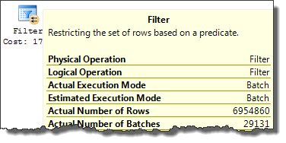
Batch mode processing

Slide 38
Batch mode processing
WARNING!!!!!
Documentation on batch processing is hard to find
Slides to follow are based on:
Information I found
Internet
a.o. http://sites.computer.org/debull/A12mar/apollo.pdf
Presentations from Microsoft speakers
Conor Cunningham – SQLBits X keynote; SQLRally Nordic
Educated guesswork to fill the gaps

Slide 39
Batch mode processing
Processor
good
Memory
(data cache)
bad
Disk
Disk
Disk

Slide 40
Batch mode processing
Processor
Core
Core
Lv 1 Instr cache (8-64 Kb)
Lv 1 Data cache (8-64 Kb)
Lv 1 Instr cache (8-64 Kb)
Lv 1 Data cache (8-64 Kb)
superb
great
superb
great
Level 2 cache (100s Kb)
Level 2 cache (100s Kb)
good
good
Level 3 cache (several MB)
good
so-so
Memory
(data cache)
bad
Disk
Disk
Disk

Slide 41
Batch mode processing
Row mode (traditional)
Process one row at a time
Batch mode
Process a whole batch at a time
Batch size chosen to fit in L2 cache

Slide 42
Batch mode processing
Batch structure
Uses vectors
(C++ array with fast random access)
Batch
per-column metadata
Qualifying rows bitmap
Column 1 data
Column 2 data
Column 3 data
Column 4 data

Slide 43
Batch mode processing
Refresher: Row mode processing
(this is fairly well documented)
GetRow()
GetRow()
?

GetRow()
?

GetRow()

Slide 44
Batch mode processing
New: Batch mode processing
(this is minimally documented)
?
GetSome()
GetSome()
















Slide 45
Batch mode processing
Advantages of batch mode processing
Less method calling overhead
Less L1 Instruction cache misses
Less L2 cache misses for data
Better parallelism
Avoids data skew in typical row mode parallel plans, because each batch can be served by each thread

Slide 46
Batch mode processing
Limitations for batch mode processing
Parallel execution required
Only a few operators supported (currently)
Filter, Project, Scan, Local hash (partial) aggregation, Hash inner join, (Batch) hash table build
Optimizer usually won’t rewrite, so you’ll need to manually rewrite query to use batch mode
See http://social.technet.microsoft.com/wiki/contents/articles/4995.sql-server-columnstore-performance-tuning.aspx
Or recording of my session at SQLBits X in London, March 31 2012
Or come to my session at SQL Connections, Las Vegas, October 3, 2013

Slide 47
Batch mode execution
Why all these parallelism operators?
One is used for transition from batch to row mode
Rest does nothing
Needed for possible fallback to row mode
(Which can happen if a hash table overflows, because batch mode does not support hash table spill)

Slide 48
Batch mode execution
Traditional (row mode) star-join optimization
FROM FactResellerSales AS rs
INNER JOIN DimSalesTerritory AS st
ON st.SalesTerritoryKey = rs.SalesTerritoryKey
WHERE st.SalesTerritoryCountry = 'Canada'

Slide 49
Batch mode execution
New (batch mode) star-join optimization
FROM FactResellerSales AS rs
INNER JOIN DimSalesTerritory AS st
ON st.SalesTerritoryKey = rs.SalesTerritoryKey
WHERE st.SalesTerritoryCountry = 'Canada'

Slide 50
Wrap up
Columnstore index
Massive I/O reduction
Limitations (read only, data types)
Batch mode processing
Massive processing speedup
Limitations (few operators, manual rewrites)

Slide 51
T H E E N D
Ask me after the session
Ask me later
Email: hugo@perFact.info
Twitter: @Hugo_Kornelis
Ask someone else
http://social.msdn.microsoft.com/Forums/en-US/category/sqlserver
Twitter: #sqlhelp
Questions?

