Slide 1
SQL Trace vs Extended Events
David Barbarin
Database Architect
david.barbarin@insentia.ch
http://mikedavem.developpez.com
http://blog.developpez.com/mikedavem

Slide 2
Summary
Extended events and architecture
Demo

Slide 3
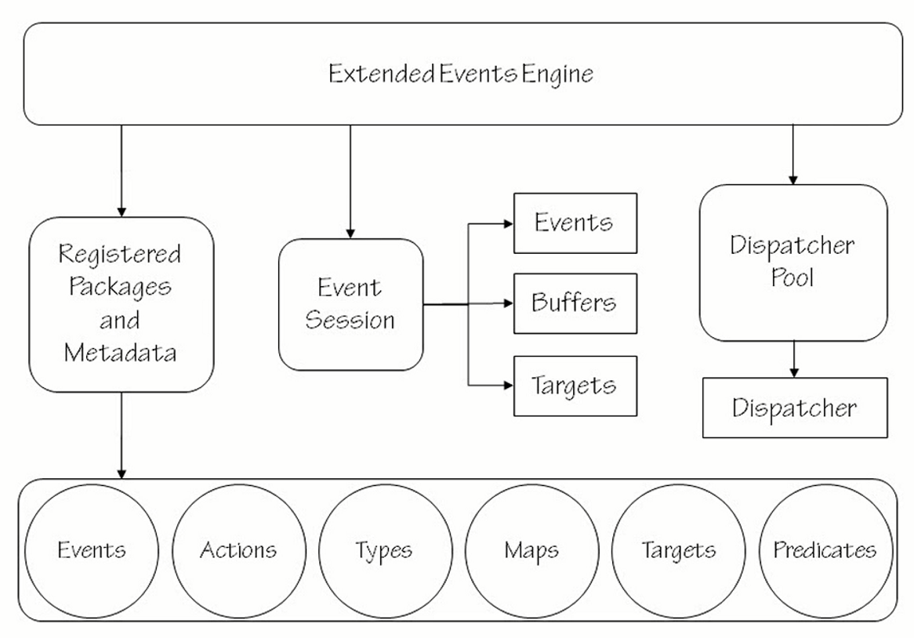
Extended event engine

Slide 4
Pre versus Post processing
Post-processing : Collecting every event and then don't worry about reducing data set after you’ve collected the data
Pre-processing : Filtering events as part of the event generation code and therefore can “short-circuit” the event from firing.
EXTENDED EVENTS

Slide 5
Extended event execution life cycle
Collect
Pre-collect :
Is enabled ?
Collect Event data Collected
Post-collect
Predicate evalution
Publish
Actions executed
Synchronous target served
Event data buffered for async targets

Slide 6
SQL traces vs Extended events
SQL Traces
Deprecated since SQL Server 2012
All events share a fixed set of data columns that requiring some columns to be overloaded (different meaning for different event)
Events generate all of the data, even when the trace doesn’t require all of the data columns to be collected
Filtering is only applied after the event has fired completly when enable in the trace controller
Trace IO providers only allow for post- collection analysis of trace data
Extended Events
Each event provides mimimum schema of data that is specific to the event being fired
Events are filtered early in the firing cycle, based on predicates
Events only collect the basic data and columns need for predicate evaluation
Any additionnal data required to complete event firing is collected after the predicate evaludation
Targets provide specialized aggregation of data for complex analysis or live analysis

Slide 7
Extended events and components
Packages
Events
Actions
Target
Predicates
Maps
Types

Slide 8
Packages
Packages contain XE objects metada
Events
Actions
Predicates
Maps
Types
Targets
Messages

Slide 9
Packages
Number of packages is growing with the newer SQL Server versions
SQL 2008 (4 packages / )
SQL 2012 (9 packages / 627 events)
SQL 14 (13 packages / 763 events)
package0, sqlos, sqlserver, secAudit

Slide 10
Events
An event corresponds to a well-know point in the code (CheckPoint, Page split, FileGrowth …)
Delivers a basic payload of information defined by a schema
Events may contain customizable (optional) data elements collected when specified
Events are defined using the ETW model (channel, keyword) to allow integration with ETW

Slide 11
Actions
Additionnal state of data to an event
Actions are executed after predicates evaluation
Execute synchronously on the thread that fires the event
Some actions can have a side effect
Use TRACK_CAUSALITY rather than perform post-collection event correlation

Slide 12
Predicates
Boolean expressions that define the conditions required for an event to fire
Predicates support short-circuit evaluation
Using of basic or textual operators (eg. >, =, < or compare_i_unint64, like_i_sql_unicode_string)
Operate to an event column or to a global field

Slide 13
Maps
Tables that provide a lookup between code values and human readable values
Maps are used as types by the SQL Server engine

Slide 14
Types
Define data type for an event, a predicate, a target or an action

Slide 15
Targets
Consumers of events
Can be synchronous or asynchronous
Targets are memory based or file based consumers
Basic targets : ring buffer, target, event file
Specialize targets : histogram, pair matching, event counter, ETW, live data viewer
Notes:
Basic targets requiere post collecting processing to analyze data
Specialize targets can be used to simplify diagnosing problem
Histogram target (asynchronous with SQL Server 2012) is know as sychronous_bucketizer and asynchronous_bucketizer in SQL Server 2008
Histogram aggregates events into buckets creating an histogram of the frequency that events fire
Only provides a count of occurrences
Pair matching target
Matches events based on a criteria and discards the matched pair, leaving unmatched events only as data
Be sur events can be paired (eg. Locks acquired, lock released → Lock escalation case for example : many locks are acquired but only one lock is released)
Same XML output as the ring_buffer target
Event_counter
Count events occured for an event session
Can be use when defined an event session for an unknow workload to determine how many events you can except based on you event session’s definition → useful for definied the appropriate targets to use for the concerned session
ETW
Integrates diagnostics data generated by SQL Server with event Tracing for Windows (ETW)
Leverages the classic ETW provider and not the newer Windows 2008+ manifest-based ETW provider in Windows
→ Backwards compability only with older versions of Windows
→ Useful for developpers and to understand how things work but impratical for general administration work
Live Data viewer
Attaches a streaming target to the event session and reads live event stream as the memory buffers are dispatched by the server
Reads the raw event data for the concerned session, even if no targets are defined to read row data
Will be disconnected by SQL Server if the number of events being generated exceeds what can be buffered without performance impact to the UI
Limited to display one million of rows

Slide 16
Session options
MAX_MEMORY
MEMORY_PARTITION_MODE
EVENT_RETENTION_MODE
MAX_DISPATCH_LATENCY
MAX_EVENT_SIZE
TRACK_CAUSALITY
STARTUP_STATE

Slide 17
Session option : MAX_MEMORY
Configures the relative maximum size of the event session buffer
Correlates directly to the MEMORY_PARTITION_MODE option
Control the size of the file writes to a file target for heavily event sessions
Default is 4 MB

Slide 18
Session option : MEMORY_PARTITION_MODE
Determines the final number of buffers for an event session
NODE (default) = 3 buffers
PER_NODE = 3 buffers for each NUMA node
PER_CPU = 2.5 buffers for each scheduler
Notes:
NODE = 3 buffers (default)
PER_NODE = 3 buffers for each NUMA node (node locality improvments for event session --> performance improvment)
PER_CPU = 2.5 buffers per scheduler
When event generation is expected important, may allow the event session to retain events that would be dropped with others partionning modes
Allows to control the buffer size and allocate 2.5 buffers for each scheduler --> data in buffer can be consumed by an asychronous while other buffer can fill

Slide 19
Session option : EVENT_RETENTION_MODE
Determines whether single event, entire buffer or no events can be lost by XE session
NO_EVENT_LOSS can impact performance under heavy event generation
NO_EVENT_LOSS can limit the number of events (eg. page_read)

Slide 20
Session option : MAX_DISPATCH_LATENCY
Configures the maximum time an event will remain in a memory buffer before being dispatch to asynchronous target
Default is 30 secondes

Slide 21
Session option : MAX_EVENT_SIZE
Etablishes the size of large buffers associated with an event for collection of events larger than the buffer standard size
MAX_EVENT_SIZE >= MAX_MEMORY
Necessary for event sessions that capture large events (collecting IOData, sql_text …)

Slide 22
Session option : TRACK_CAUSALITY
Powerfull option for events correlation
Adds the attach_activity_id and attach_activity_id_xfer actions to every event for event to correlate events and the order they fired
Attach_activity_id_xfer is attached to events that transfer activities for end-to-end tracking of events for correlation
Default is OFF
Notes:
Attach_activity_id_xfer comprises two parts :
GUID : track events that relate to each other
A sequence number (seq) : provides the order the events fired within a sequence

Slide 23
Session option : STARTUP_STATE
Configures the event session to start automatically when SQL Server starts
Default is OFF
Notes:
Event session definition is stored in system catalog vs SQL trace defined in master database and related procedure is marked to start automatically with SQL Server

Slide 24
DMVs
sys.server_event_sessions
sys.server_event_session_events
sys.server_event_session_actions
sys.server_event_session_fields
sys.server_event_session_targets

Slide 25
DMVs
sys.dm_xe_sessions
sys.dm_xe_session_targets
sys.dm_xe_session_events
sys.dm_xe_session_event_actions
sys.dm_xe_session_object_columns

Slide 26
DMVs / DMF
sys.dm_xe_packages
sys.dm_xe_objects
sys.dm_xe_object_columns
sys.dm_xe_map_values
sys.dm_os_dispatcher_pools
sys.fn_xe_file_target_read_file()

Slide 29
Nos sponsors

Slide 30
LINKS
Les événements étendus avec SQL Server 2008 (Nicolas Souquet)
Nouveaux événements étendus avec SQL Server 2012 (David Baffaleuf)
An Xevent a day (Jonathan Kehayias)

